Slide 1
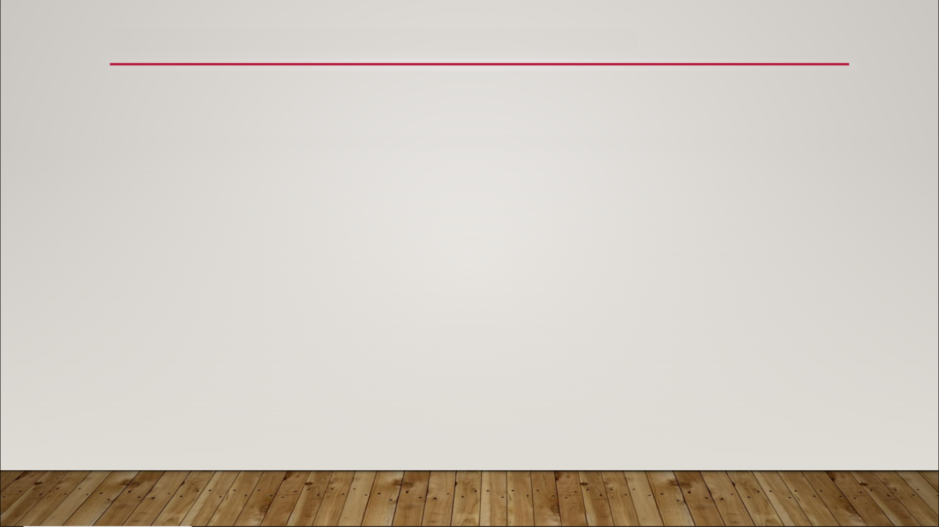
Vector Nodes
normal vector - the vector perpendicular to the surface of an object at any given point
normalized vector - vector that has been converted to a unit vector
unit vector - any vector with a magnitude of 1

Slide 2
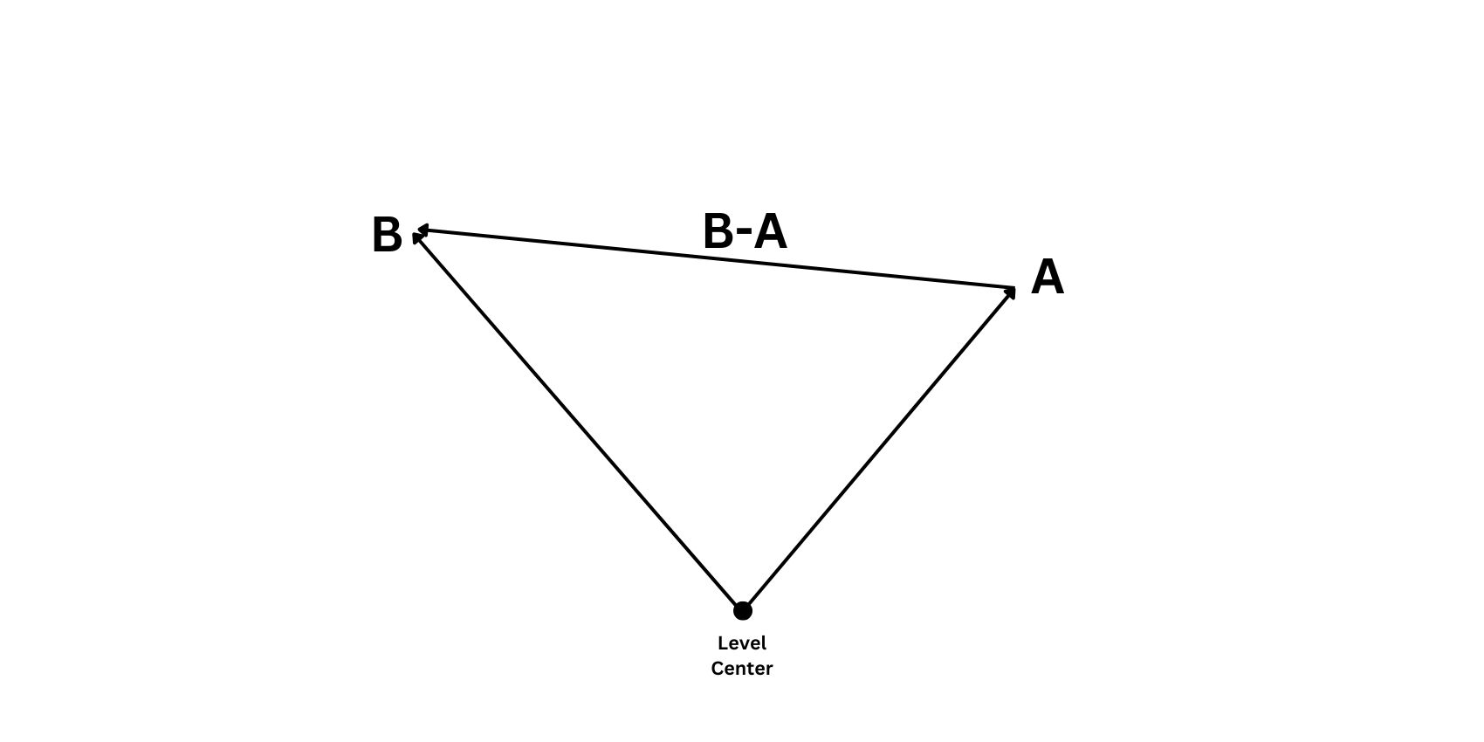
Vector Nodes

